Slide 1

MTN-017 Product Dispensation and Return CRF (PDR)

Slide 2
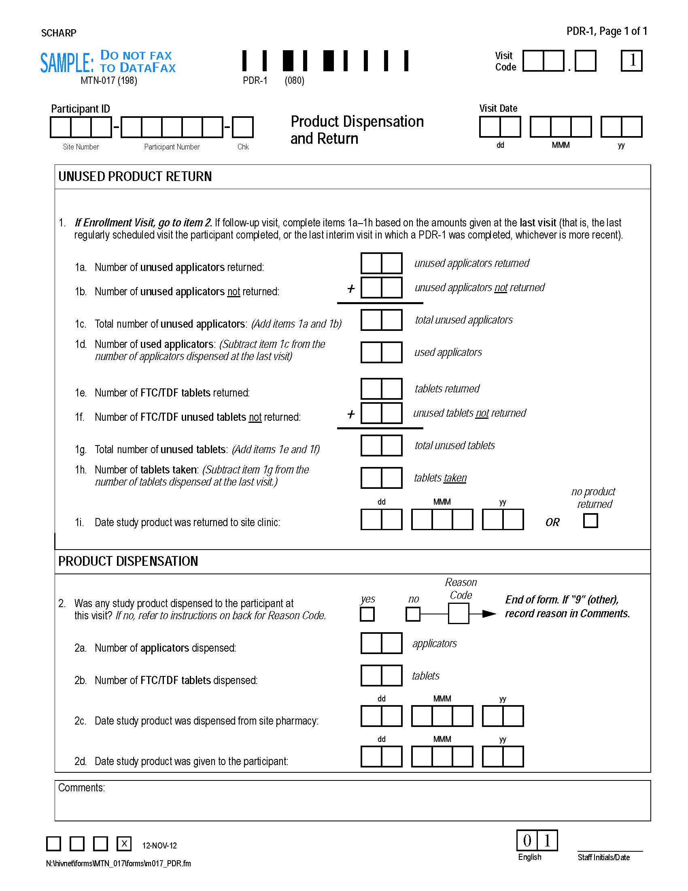
Unused product returns
section
(completed at f/u visits only)
Product Dispensation
section
Notes:
Captures applicator and tablet dispensations and unused returns

Slide 3
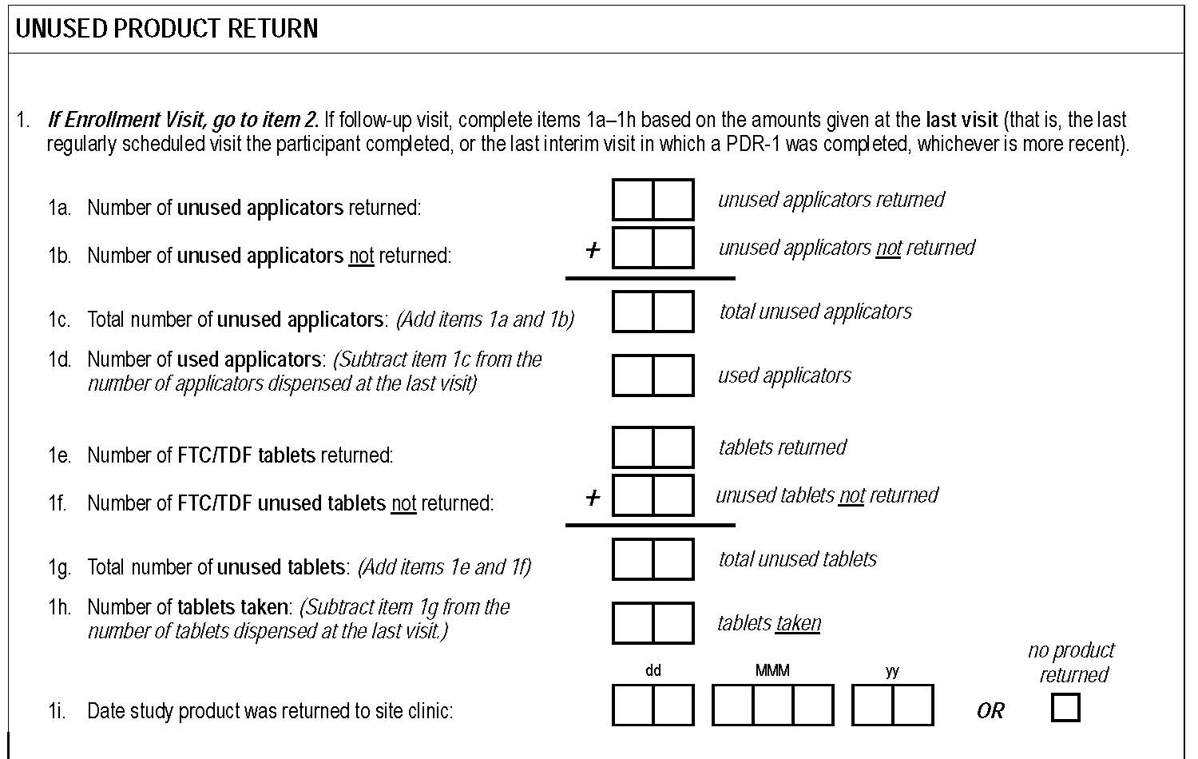
Unused Tablets
Unused Applicators
Notes:
(Dispensing section covered in enrollment slides). All returns items must be completed at each required follow-up visit. Items 1d and 1h require calculations based on last dispensation (need to refer to last PDR completed). Captures unused product returned and unused product not returned (left at home); the latter is collected to avoid overestimating adherence due to unused product not being returned. SCHARP WILL DEVELOP EXCEL TOOL TO HELP WITH CALCULATIONS.

Slide 4
Complete first
Notes:
Complete boxed items first – responses needed in order to use the tool

Slide 5
Unused product not returned (e.g., left at home) based on participant self-report*
Notes:
Captured to avoid overestimating adherence due to ppt failure to return unused product –
NUMBERS MUST MATCH UP, such that the number dispensed minus the number returned should equal the number not returned

Slide 6
Calculate Unused and Used Doses
Use Product Count Tool
Notes:
Must refer to the amount dispensed (if any) as recorded on the last PDR completed for the given ppt. This info is used for the data convergence interviews.

Slide 7

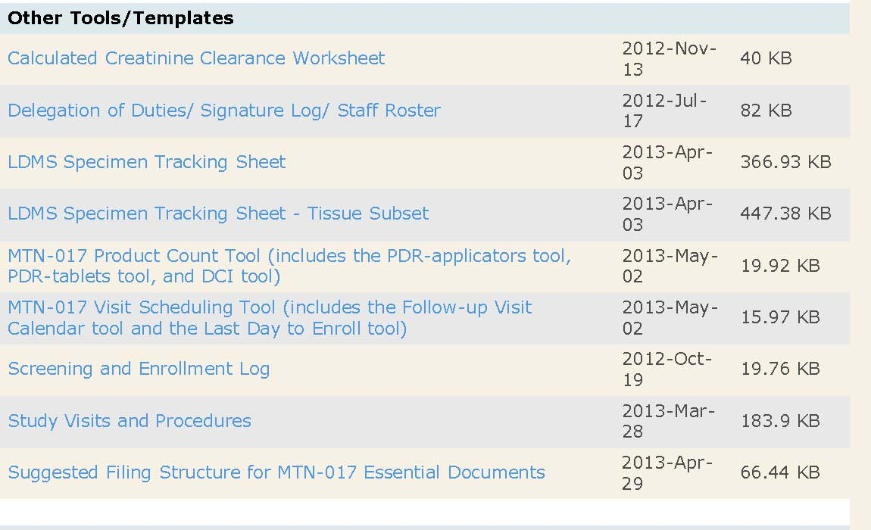
Finding the MTN-017 Product Count Tool

Slide 8
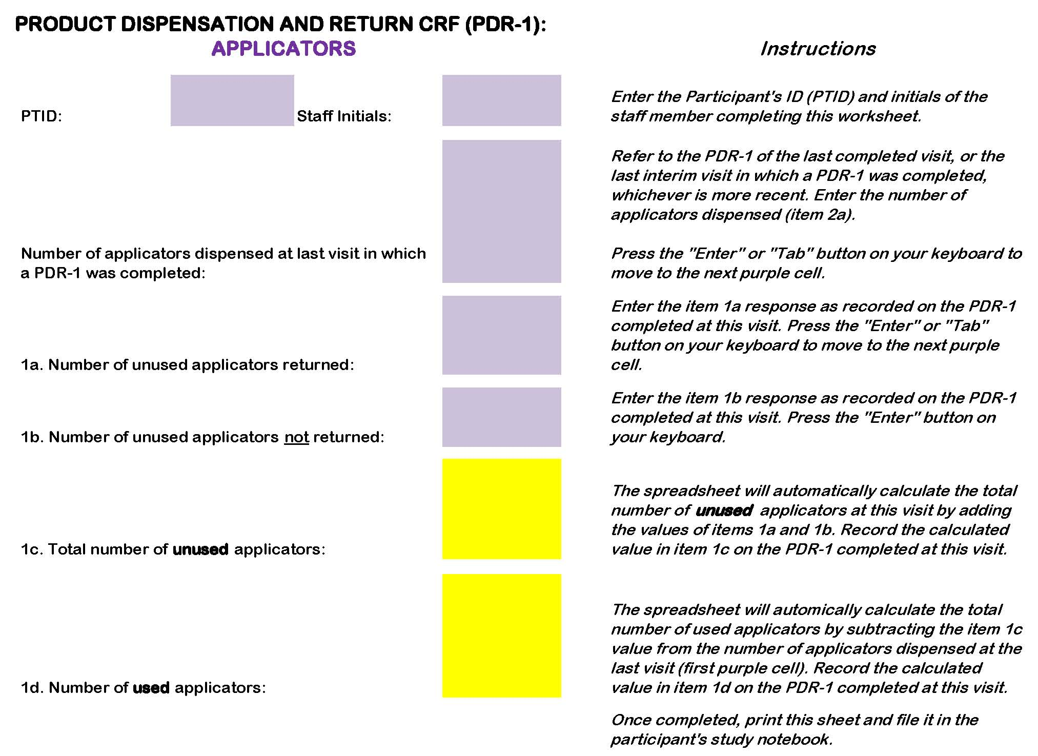
Notes:
Tab 1 of tool – completed sheet printed/filed, serves as source document for items 1c and 1d

Slide 9
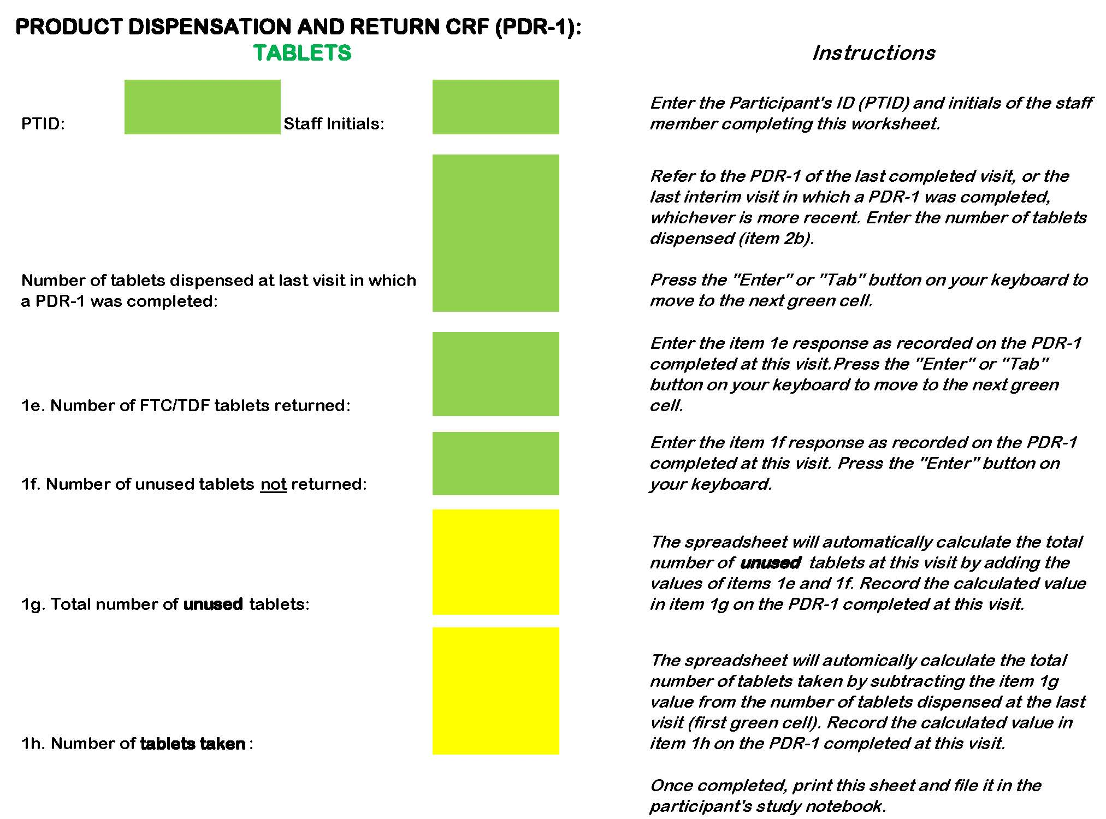
Notes:
Tab 2 of tool - completed sheet printed/filed, serves as source document for items 1g and 1h

Slide 10
Product Dispensation and Return CRF
Completed by clinic staff
Required at Enrollment, Initiate Period, Mid-period and End period visits
Required at early termination, if applicable
Completed at interim visits only when product is dispensed or returned
  Excludes late returns
  E.g., product hold or resume, early termination

Slide 11
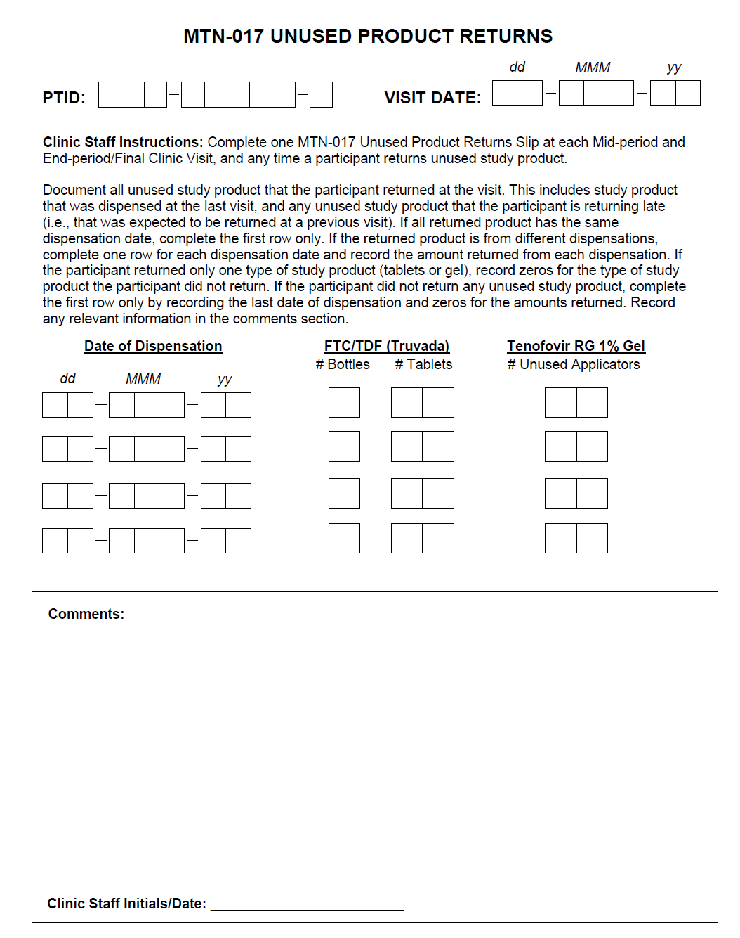
Slip is source for PDR unused product returns
All product returned (on time or late) at a given visit is recorded on slip for that visit
Notes:
Slip is source for all unused product a participant brings back at a given visit – includes both on-time and late returns
In other words, anything she walks in with is recorded on the slip completed for that visit.

Slide 12
Comments section is source for all unused product not returned, per ppt self-report
Notes:
#s must add up (not returned+returned=amount last dispensed)

Slide 13
For given visit, only transcribe onto PDR unused product counts from dispensed amounts as recorded on last PDR CRF
Notes:
Only “on time” returns transcribed onto PDR for current visit (late returns documented via updates to previously completed PDR forms)
CRF guidance allows us to collect count of unused product that was not returned (avoids overestimating adherence) while not double counting same unused product across visits – can estimate adherence from visit to visit (CRF to CRF). Define “last PDR” on slide after next.

Slide 14
Transcribe late returns by updating previously completed PDR forms
Notes:
CRF guidance allows us to collect count of unused product that was not returned (avoids overestimating adherence) while not double counting same unused product across visits – can estimate adherence from visit to visit (CRF to CRF). Define “last PDR” on next slide.

Slide 15
Defining Last PDR for Product Returns
Enrollment
Initiate Period 2 (Visit 5)
Initiate Period 3 (Visit 8)
Mid-period 1 (Visit 3)
Mid-period 2 (Visit 6)
Mid-period 3 (Visit 9)
End Period 1 (Visit 4)
End Period 2 (Visit 7)
End Period 3 (Visit 10)
PDR required at each of these visits
At each f/u visit, document unused returns from amount dispensed at previously completed visit only (i.e., last visit when PDR completed)
Notes:
First bullet point – Emphasize that this is true even in context of product hold/discontinuation (way DataFax visit map expectation is built).
Second bullet point – This rule allows for two things: tracking adherence from visit to visit (between visits), and avoids double counting the same product (since we account for unused product that is not returned/left at home) at each visit. Clarify that “amount dispensed” in most cases will be 0 (End Period Visit) or 30 (Initiate or Mid-period Visit).

Slide 16
Defining Last PDR for Product Returns
Enrollment
Initiate Period 2 (Visit 5)
Initiate Period 3 (Visit 8)
Mid-period 1 (Visit 3)
Mid-period 2 (Visit 6)
Mid-period 3 (Visit 9)
End Period 1 (Visit 4)
End Period 2 (Visit 7)
End Period 3 (Visit 10)
Retention:

Slide 17
Defining Last PDR for Product Returns
Enrollment
Initiate Period 2 (Visit 5)
Initiate Period 3 (Visit 8)
Mid-period 1 (Visit 3)
Mid-period 2 (Visit 6)
Mid-period 3 (Visit 9)
End Period 1 (Visit 4)
End Period 2 (Visit 7)
End Period 3 (Visit 10)
Retention:
On Visit 3 PDR, document only unused product from enrollment dispensation

Slide 18
Defining Last PDR for Product Returns
Enrollment
Initiate Period 2 (Visit 5)
Initiate Period 3 (Visit 8)
Mid-period 1 (Visit 3)
Mid-period 2 (Visit 6)
Mid-period 3 (Visit 9)
End Period 1 (Visit 4)
End Period 2 (Visit 7)
End Period 3 (Visit 10)
Retention:
On Visit 4 PDR, document only unused product from Visit 3 dispensation.

Slide 19
Defining Last PDR for Product Returns
Enrollment
Initiate Period 2 (Visit 5)
Initiate Period 3 (Visit 8)
Mid-period 1 (Visit 3)
Mid-period 2 (Visit 6)
Mid-period 3 (Visit 9)
End Period 1 (Visit 4)
End Period 2 (Visit 7)
End Period 3 (Visit 10)
Retention:
On Visit 5 PDR, document ZERO unused, since “00” product dispensed at Visit 4.

Slide 20
Defining Last PDR for Product Returns
Enrollment
Initiate Period 2 (Visit 5)
Initiate Period 3 (Visit 8)
Mid-period 1 (Visit 3)
Mid-period 2 (Visit 6)
Mid-period 3 (Visit 9)
End Period 1 (Visit 4)
End Period 2 (Visit 7)
End Period 3 (Visit 10)
Retention:
On Visit 6 PDR, document only unused product from Visit 5 dispensation.

Slide 21
Defining Last PDR for Product Returns
Enrollment
Initiate Period 2 (Visit 5)
Initiate Period 3 (Visit 8)
Mid-period 1 (Visit 3)
Mid-period 2 (Visit 6)
Mid-period 3 (Visit 9)
End Period 1 (Visit 4)
End Period 2 (Visit 7)
End Period 3 (Visit 10)
Retention:
At Visit 8, last PDR completed was at Visit 6
(Visit 7 was missed).
Document only unused product from Visit 6 dispensation.

Slide 22
Defining Last PDR for Product Returns
Enrollment
Initiate Period 2 (Visit 5)
Initiate Period 3 (Visit 8)
Interim Visit
Mid-period 1 (Visit 3)
Mid-period 2 (Visit 6)
Mid-period 3 (Visit 9)
End Period 1 (Visit 4)
End Period 2 (Visit 7)
End Period 3 (Visit 10)
Complete PDR at interim visits only if product is dispensed or returned from last dispensation
If product is dispensed/returned at interim visit
document only unused product from Visit 9 dispensation
Notes:
Skipping ahead to interim visit. If at interim visit product is only returned, and it represents late returns only, then do not complete a PDR. Instead, document the returns by updating the previously completed PDR for the visit when the product was supposed to be returned.

Slide 23
Defining Last PDR for Product Returns
Enrollment
Initiate Period 2 (Visit 5)
Initiate Period 3 (Visit 8)
Interim Visit
Mid-period 1 (Visit 3)
Mid-period 2 (Visit 6)
Mid-period 3 (Visit 9)
End Period 1 (Visit 4)
End Period 2 (Visit 7)
End Period 3 (Visit 10)
If product is dispensed/returned at interim visit
On Visit 10 PDR, document only unused product from interim visit dispensation
      - could be zero if product returned but not dispensed at interim visit.
Notes:
Last PDR completed was at interim visit

Slide 24
Defining Last PDR for Product Returns
Enrollment
Initiate Period 2 (Visit 5)
Initiate Period 3 (Visit 8)
Interim Visit
Mid-period 1 (Visit 3)
Mid-period 2 (Visit 6)
Mid-period 3 (Visit 9)
End Period 1 (Visit 4)
End Period 2 (Visit 7)
End Period 3 (Visit 10)
Complete PDR at interim visits only if product is dispensed or returned
If product not dispensed/returned at interim visit
  No PDR completed at interim visit
  On Visit 10 PDR, document only unused product
  from Visit 9 dispensation.

Slide 25
Scenarios

Slide 26
Unused Product Returns Scenario 1
On 03-AUG-12, the ppt enrolled in the daily gel period. He received 30 applicators. He returned 31-AUG-12 for the Mid-period Visit.
He says he has only one unused applicator left, but it is at home.
The participant is reminded to bring that applicator and all unused product to the next clinic visit.
How would you complete the slip and CRF?

Slide 27
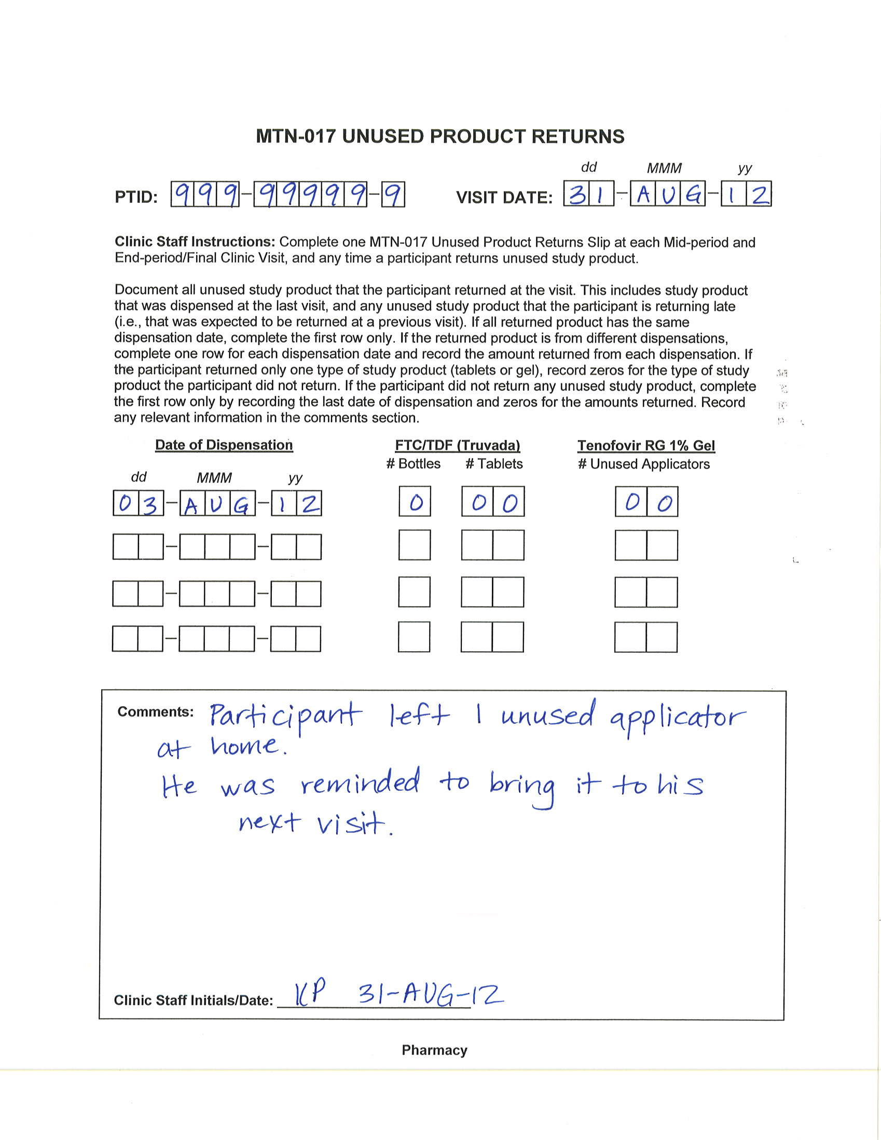

Slide 28
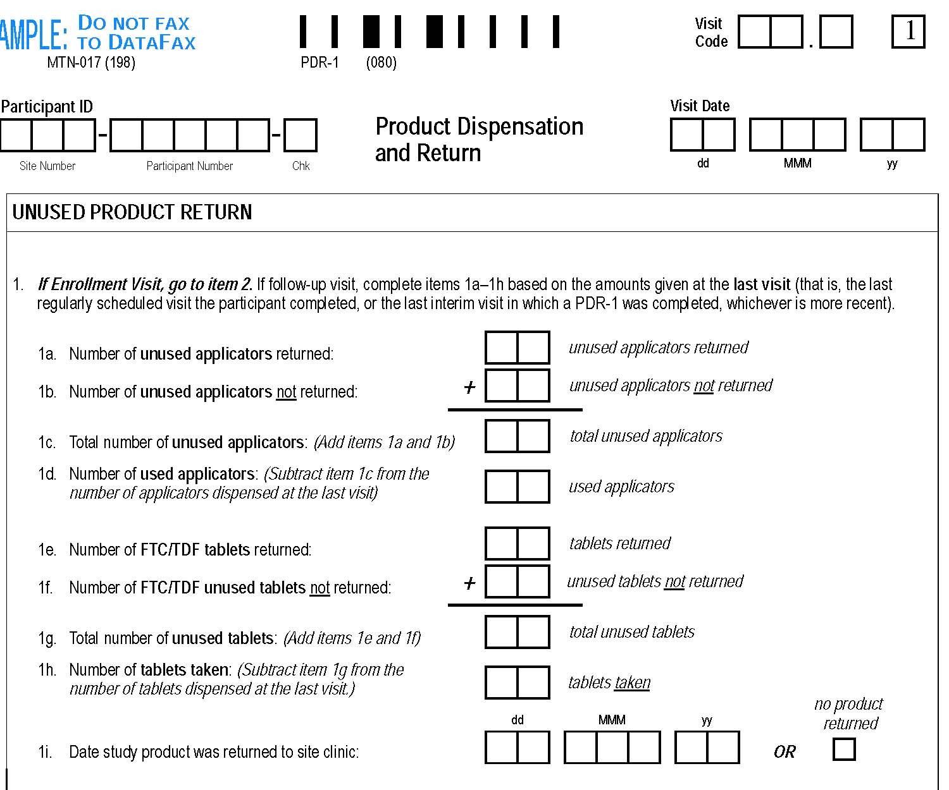
0
3
0
9
9
9
9
9
9
9
9
9
3
1
A
U
G
1
2
0
0
0
1
0
1
If 30 doses dispensed, should add up to 30
2
9
0
0
0
0
0
0
0
0
X
Notes:
Must answer all items 1a-1i, regardless of study product regimen ppt is currently on -

Slide 29
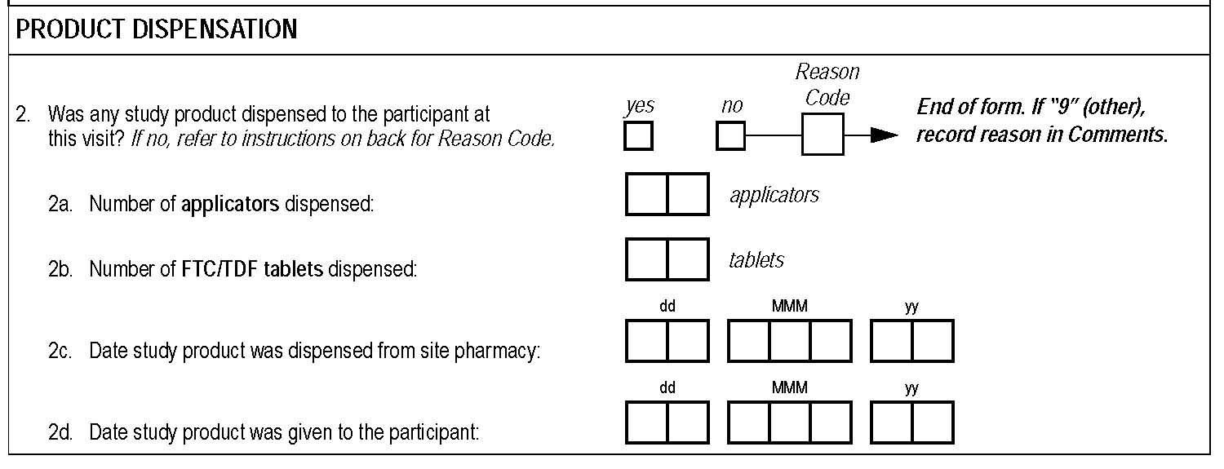
Refer to dispensed amount on previously completed PDR
X
3
0
0
0
0
3
A
U
G
1
2
0
3
A
U
G
1
2

Slide 30
Scenario 1 continued
On 28-SEP-12 participant returns for the End Period 1 Visit and says he has an unused applicator leftover from the first month and two from the past month. He forgot to bring these with him.
The participant is again encouraged to always bring back unused study product.
How would you complete the slip and CRF?

Slide 31
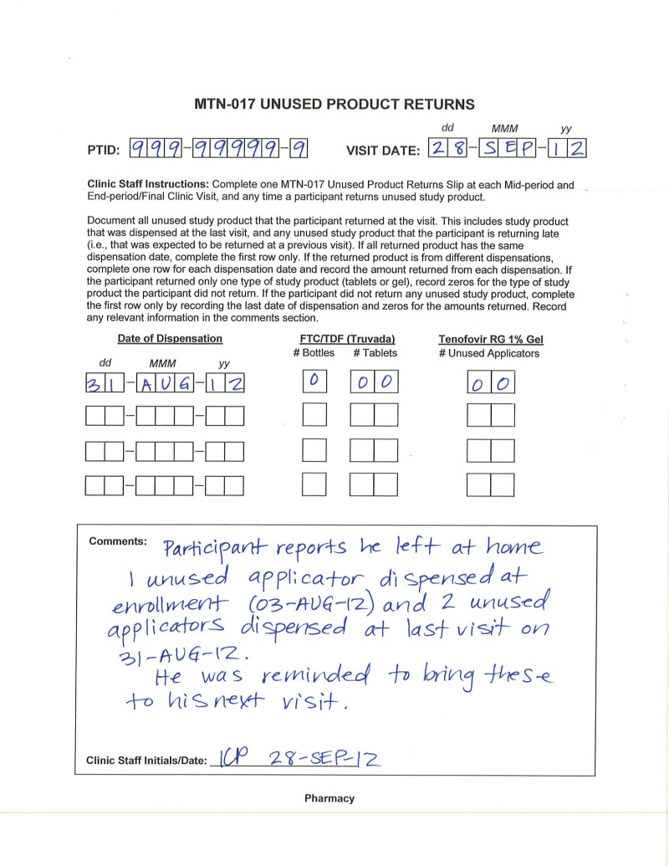

Slide 32
0
4
0
9
9
9
9
9
9
9
9
9
2
8
S
E
P
1
2
0
0
0
2
Based on last PDR documen-tation of what was dispensed
30 doses dispensed, so should add up to 30
0
2
2
8
0
0
0
0
0
0
0
0
X
Notes:
ONLY document returns from what was dispensed at the last visit – do not count late returns on this CRF to avoid double counting. The one unreturned, unused applicator that was first dispensed at enrollment is recorded on the visit 3.0 PDR in item 1b.

Slide 33
Scenario 1 continued
At his Mid-period 2 Visit on 02-NOV-12 (Period 2, oral regimen), he returns 3 unused tablets (from 08-OCT-12 Initiate Period 2 dispensation) and 3 applicators from the last period’s regimen (daily gel).
He says he has returned all unused product.
How would you complete the slip and CRF?

Slide 34
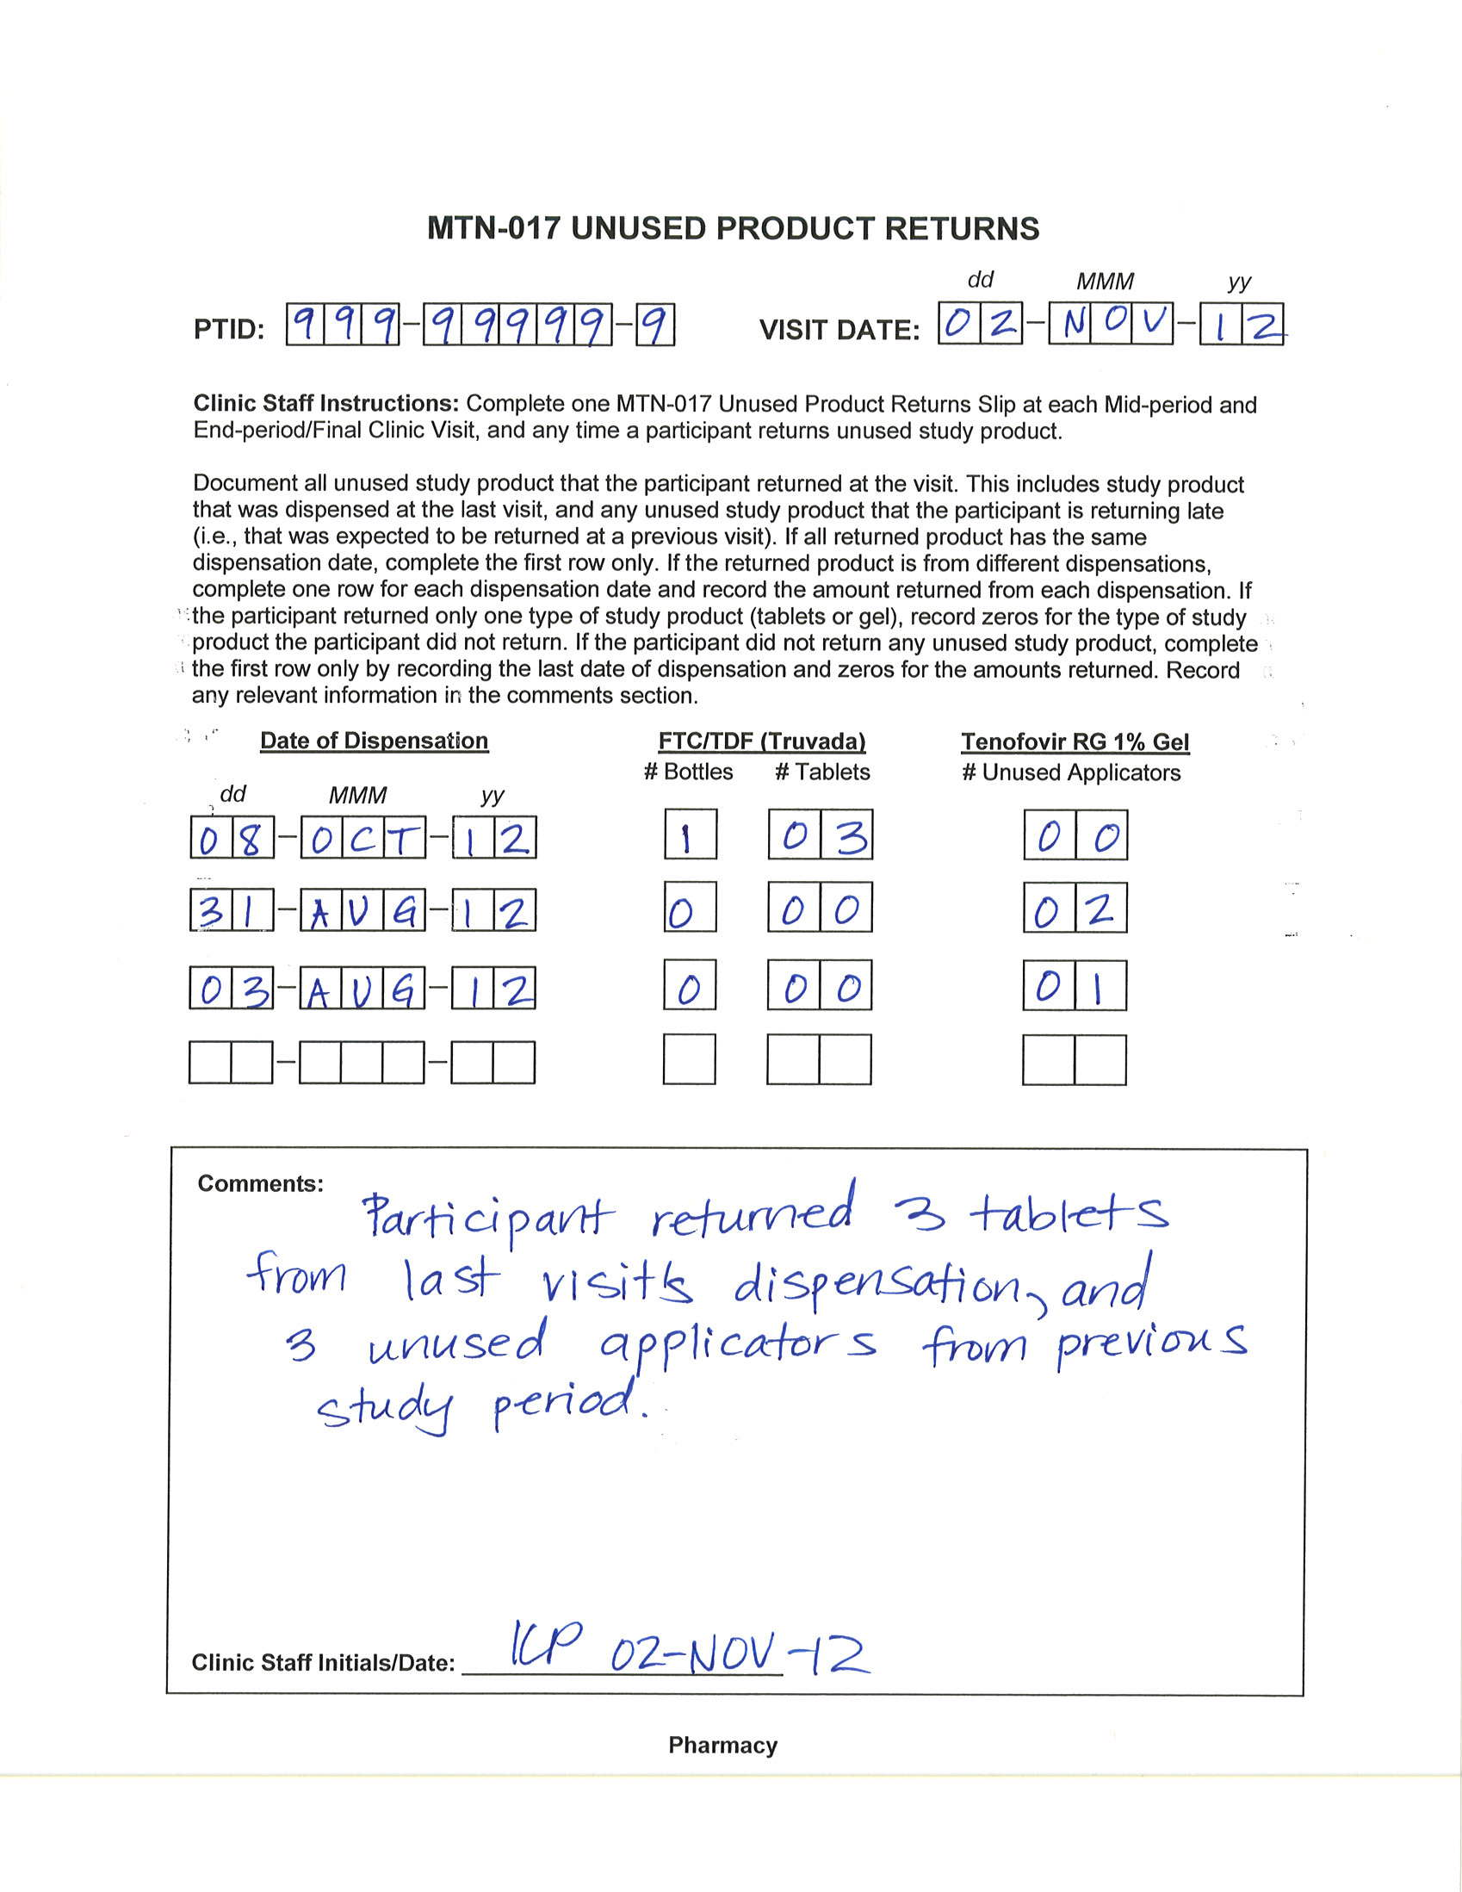

Slide 35
0
6
0
9
9
9
9
9
9
9
9
9
0
2
N
O
V
1
2
0
0
Only record returns from dispensed amounts on last PDR
0
0
0
0
0
0
If 30 doses dispensed, should add up to 30
0
3
0
0
0
3
2
7
0
2
N
O
V
1
2
Notes:
ONLY document returns from what was dispensed at the last visit – do not count late returns on this CRF to avoid double counting. The unreturned, unused applicators that were late returns were already accounted for on the visit 3.0 and 4.0 PDR CRFs in item 1b.

Slide 36
0
4
0
9
9
9
9
9
9
9
9
9
2
8
S
E
P
1
2
KP 02-NOV-12
02
0
0
00
0
2
0
2
Record late returns on previous PDR
2
8
0
0
0
0
0
0
0
0
0
2
N
O
V
1
2
X
KP 02-NOV-12
Notes:
Update previous PDR to account for late returns

Slide 37
0
3
0
9
9
9
9
9
9
9
9
9
3
1
A
U
G
1
2
KP 02-NOV-12
01
0
0
00
0
1
0
1
Record late returns on previous PDR
2
9
0
0
0
0
0
0
0
0
0
2
N
O
V
1
2
X
KP 02-NOV-12

Slide 38
Scenario 1 continued
On 30-NOV-12, the participant comes in for his End Period 2 Visit. He has 2 unused tablets that he left at home.
How would you complete the slip and CRF?
Notes:
At End Period 2 Visit record 00 returned, 02 unused not returned.

Slide 39
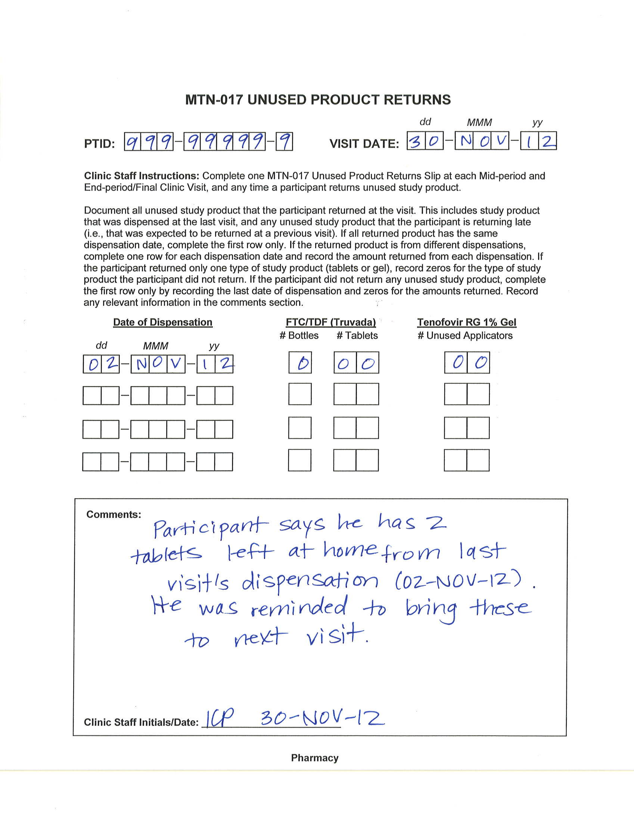

Slide 40
0
7
0
9
9
9
9
9
9
9
9
9
3
0
N
O
V
1
2
0
0
0
0
0
0
0
0
If 30 doses dispensed, should add up to 30
0
0
0
2
0
2
2
8
X

Slide 41
Scenario 1 continued
On 30-NOV-12, the participant comes in for his End Period 2 Visit. He has 2 unused tablets that he left at home.
What if the participant returned the 2 unused tablets the next day (01-DEC-12)? How would you document this?
Notes:
Split visit

Slide 42
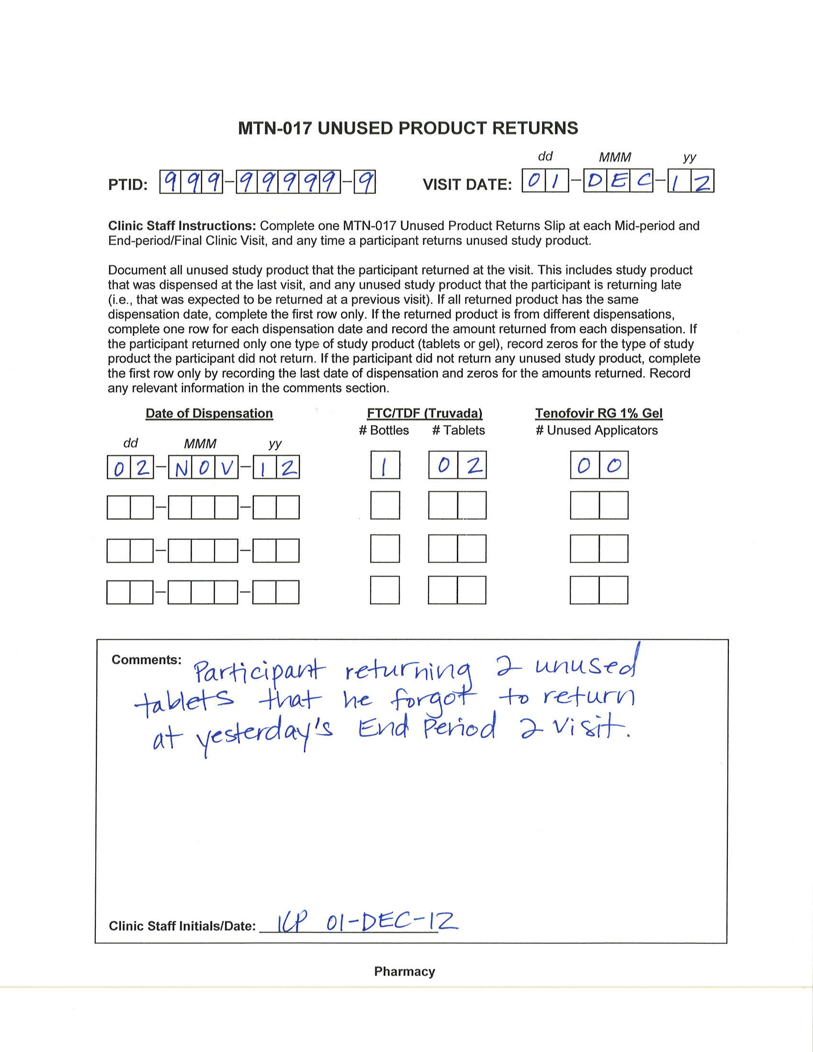
Complete new returns slip

Slide 43
0
7
0
9
9
9
9
9
9
9
9
9
3
0
N
O
V
1
2
0
0
Update CRF
(split visit)
0
0
0
0
0
0
02
0
0
00
0
2
0
2
KP 01-DEC-12
2
8
0
1
D
E
C
1
2
X
Notes:
Split visit – need to update the CRF, as we can only have one PDR in database per ppt/visit code

Slide 44
Scenario 1 continued
On 30-NOV-12, the participant comes in for his End Period 2 Visit. He has 2 unused tablets that he left at home.
What if the participant returned the 2 unused tablets at the Initiate Period 3 Visit on 07-DEC-12?
How would you document this?
Notes:
At End Period 2 Visit record 00 returned, 02 unused not returned. At Initiate Period 3 Visit, complete

Slide 45
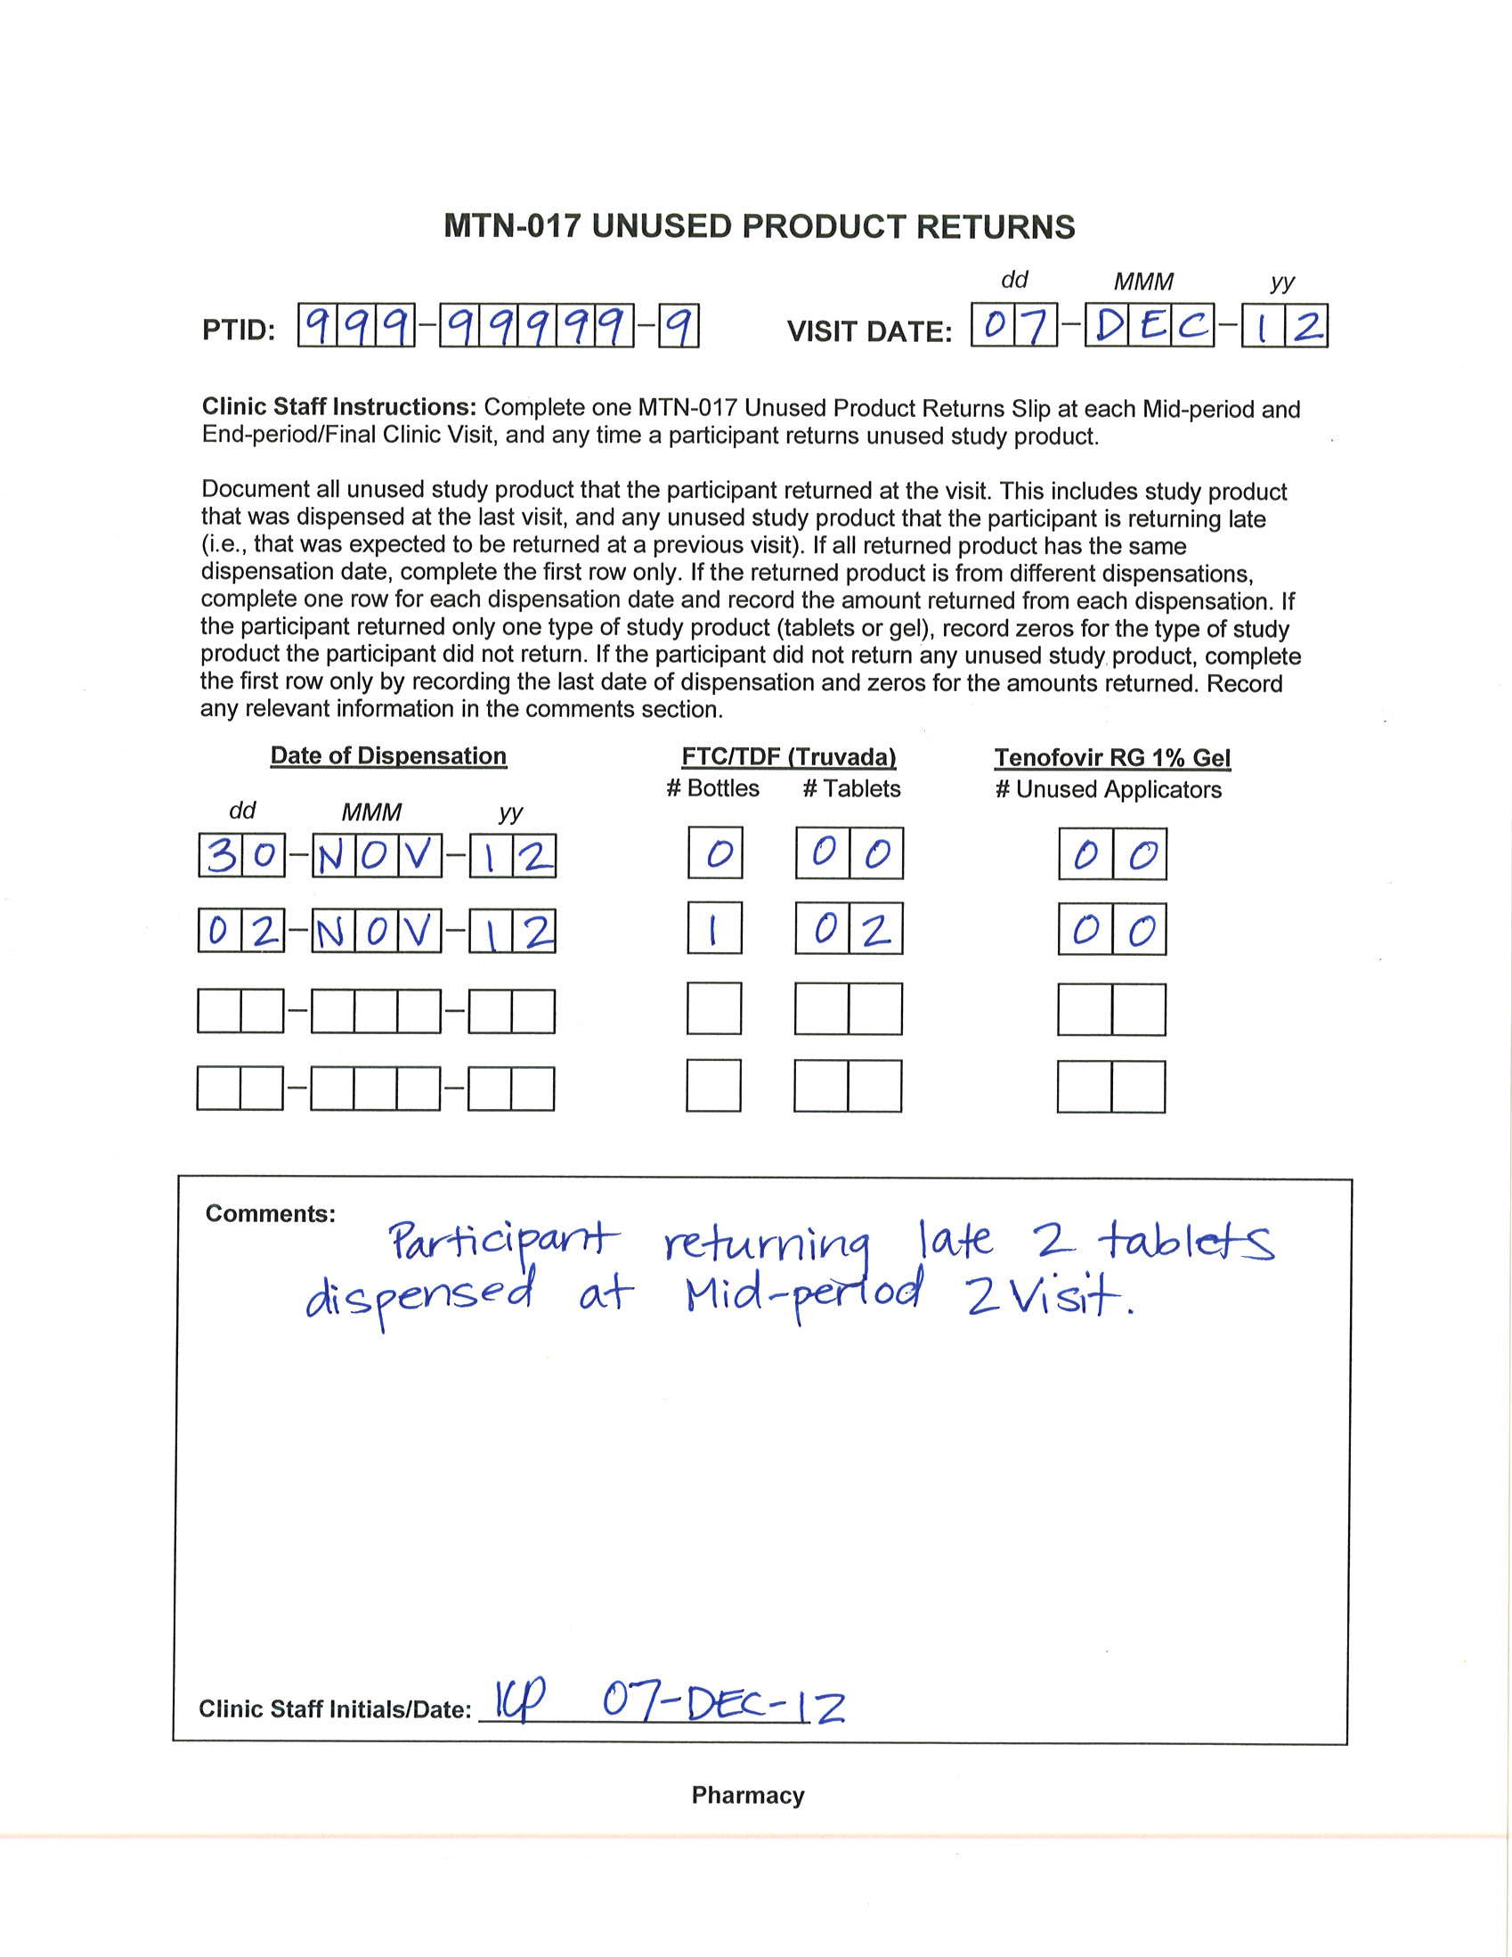
Can include last PDR date, even if no product
dispensed at that visit

Slide 46
0
8
0
9
9
9
9
9
9
9
9
9
0
7
D
E
C
1
2
0
0
0
0
0
0
0
0
Only record returns from dispensed amounts on last PDR
0
0
0
0
0
0
0
0
x
Notes:
ONLY document returns from what was dispensed at the last visit (End Period 2), which was nothing. Do not count late returns on this CRF to avoid double counting. The unreturned, unused applicators that were late returns were already accounted for on the visit 7.0 PDR in item 1f.

Slide 47
0
7
0
9
9
9
9
9
9
9
9
9
3
0
N
O
V
1
2
0
0
Document late returns on previous PDR
0
0
0
0
0
0
02
0
0
00
0
2
0
2
KP 07-DEC-12
2
8
0
7
D
E
C
1
2
X
Notes:
Update PDR of visit when product was supposed to be returned

Slide 48
Unused Product Returns Scenario 2
A participant completes his Mid-period 2 Visit (daily gel) on 30-NOV-12. Three days later (03-DEC-12), he comes in for evaluation of a grade 3 AE which warrants product hold.
  He returns all 27 of his unused applicators
How would you document this?
Notes:
Per Cindy’s request, state that the 27 unused applicators will go back to the site pharmacy.

Slide 49
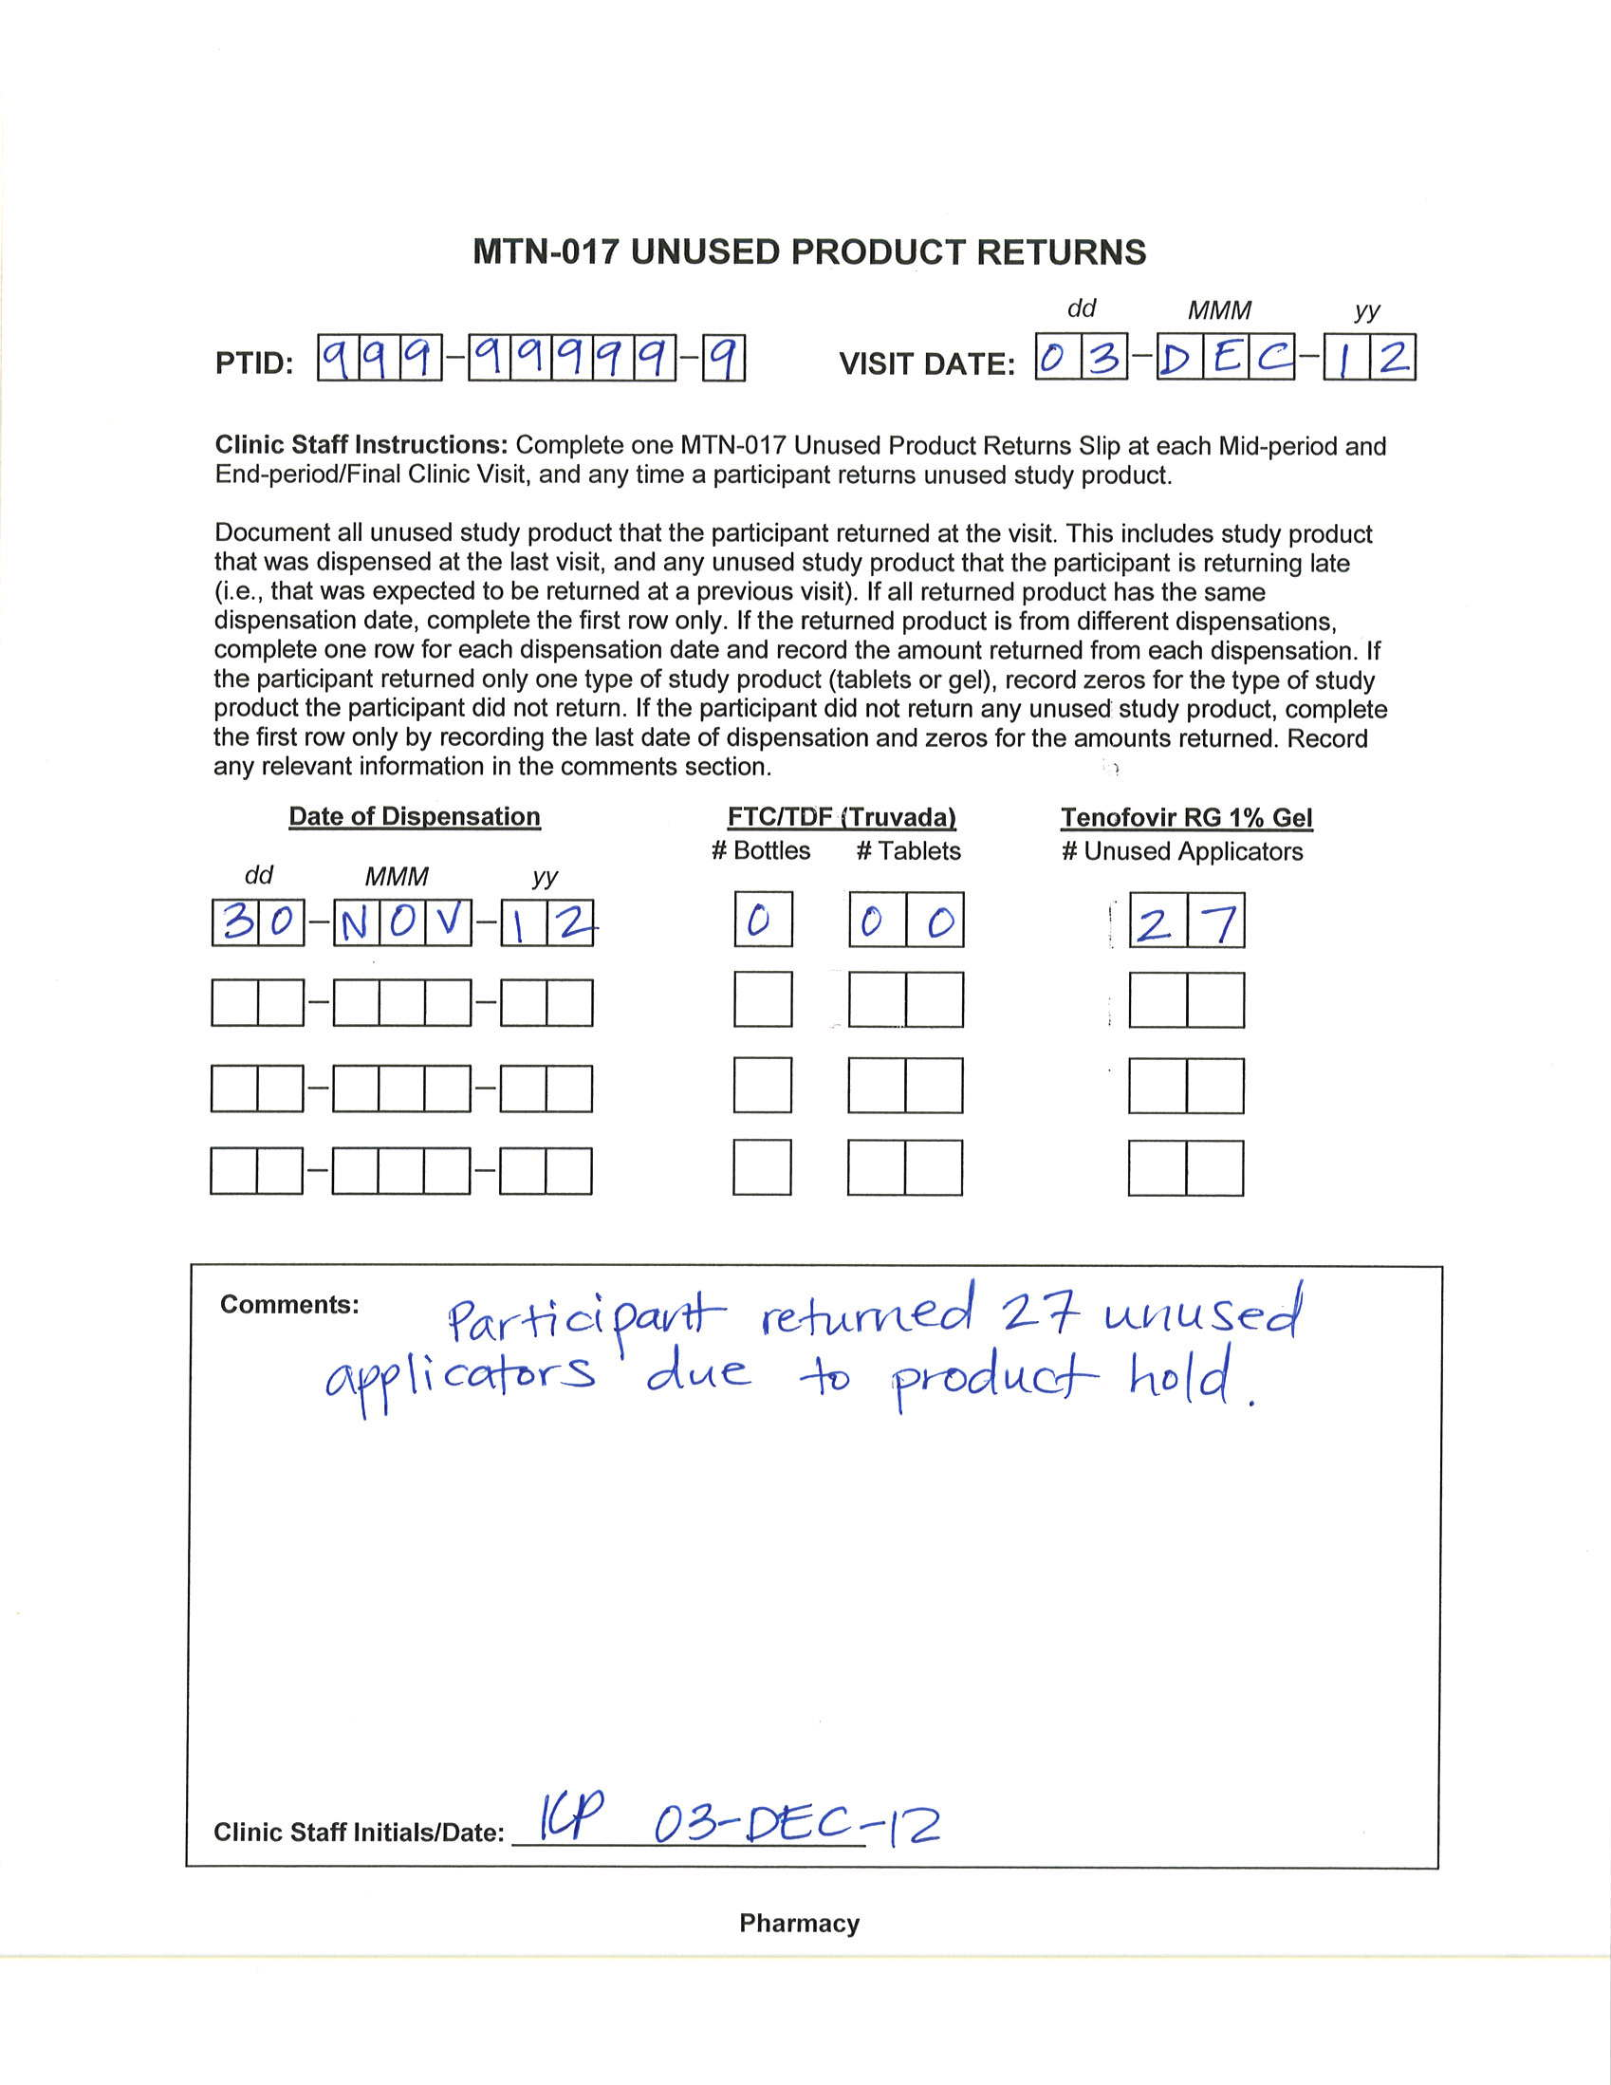

Slide 50
0
6
1
Interim visit code
9
9
9
9
9
9
9
9
9
0
3
D
E
C
1
2
2
7
0
0
2
7
0
3
0
0
0
0
0
0
0
0
0
3
D
E
C
1
2
Notes:
ONLY document returns from what was dispensed at the last visit (Mid-Period 2, visit 6.0).

Slide 51
Scenario 2 continued
A participant completes his Mid-period 2 Visit (daily gel) on 30-NOV-12. Three days later (03-DEC-12), he comes in for evaluation of a grade 3 AE which warrants product hold.
  He returns 27 unused applicators.
What if product were permanently d/c on 10-DEC-12? He returns for the End Period 2 Visit on 28-DEC-12.
  How would you complete the slip and CRF?
Notes:
At End Period 2 Visit record 00 returned, 02 unused not returned. At Initiate Period 3 Visit, complete

Slide 52
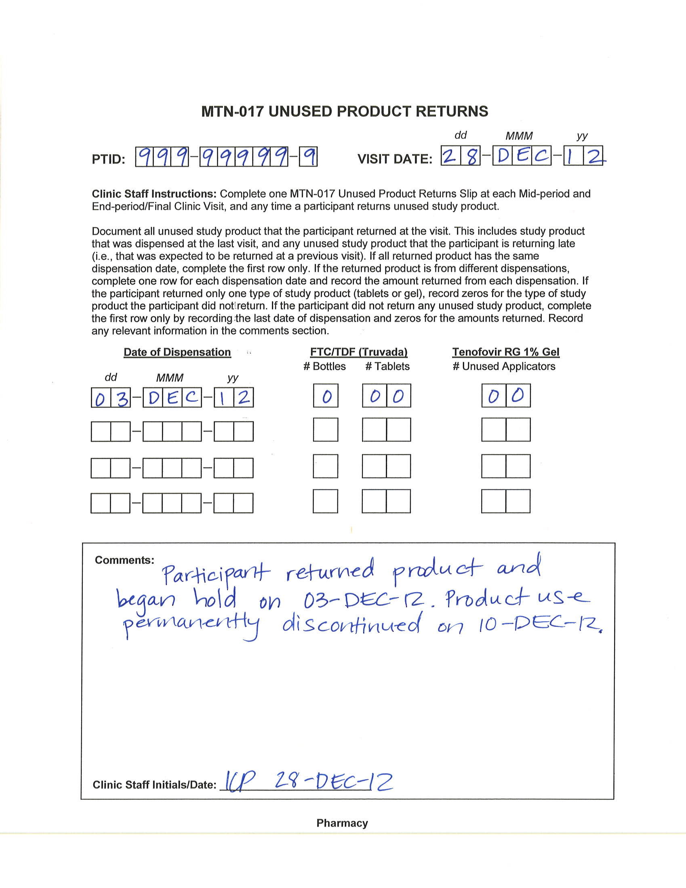
Notes:
03-DEC-12 is the date the last PDR was completed

Slide 53
0
7
0
9
9
9
9
9
9
9
9
9
2
8
D
E
C
1
2
0
0
0
0
None dispensed on last PDR (interim visit 6.1)
0
0
0
0
0
0
0
0
0
0
0
0
0
0
x
Notes:
ONLY document returns from what was dispensed on the last PDR

Slide 54
Unused Product Returns Scenario 3
A participant completes his Mid-period 2 Visit (RAI gel period) on 13-NOV-12 and is given 30 applicators.
  He misses his End Period 2 Visit.
  At his 18-DEC-12 Initiate Period 3 Visit (oral period), he says he used all of his applicators.
How would you document this?

Slide 55
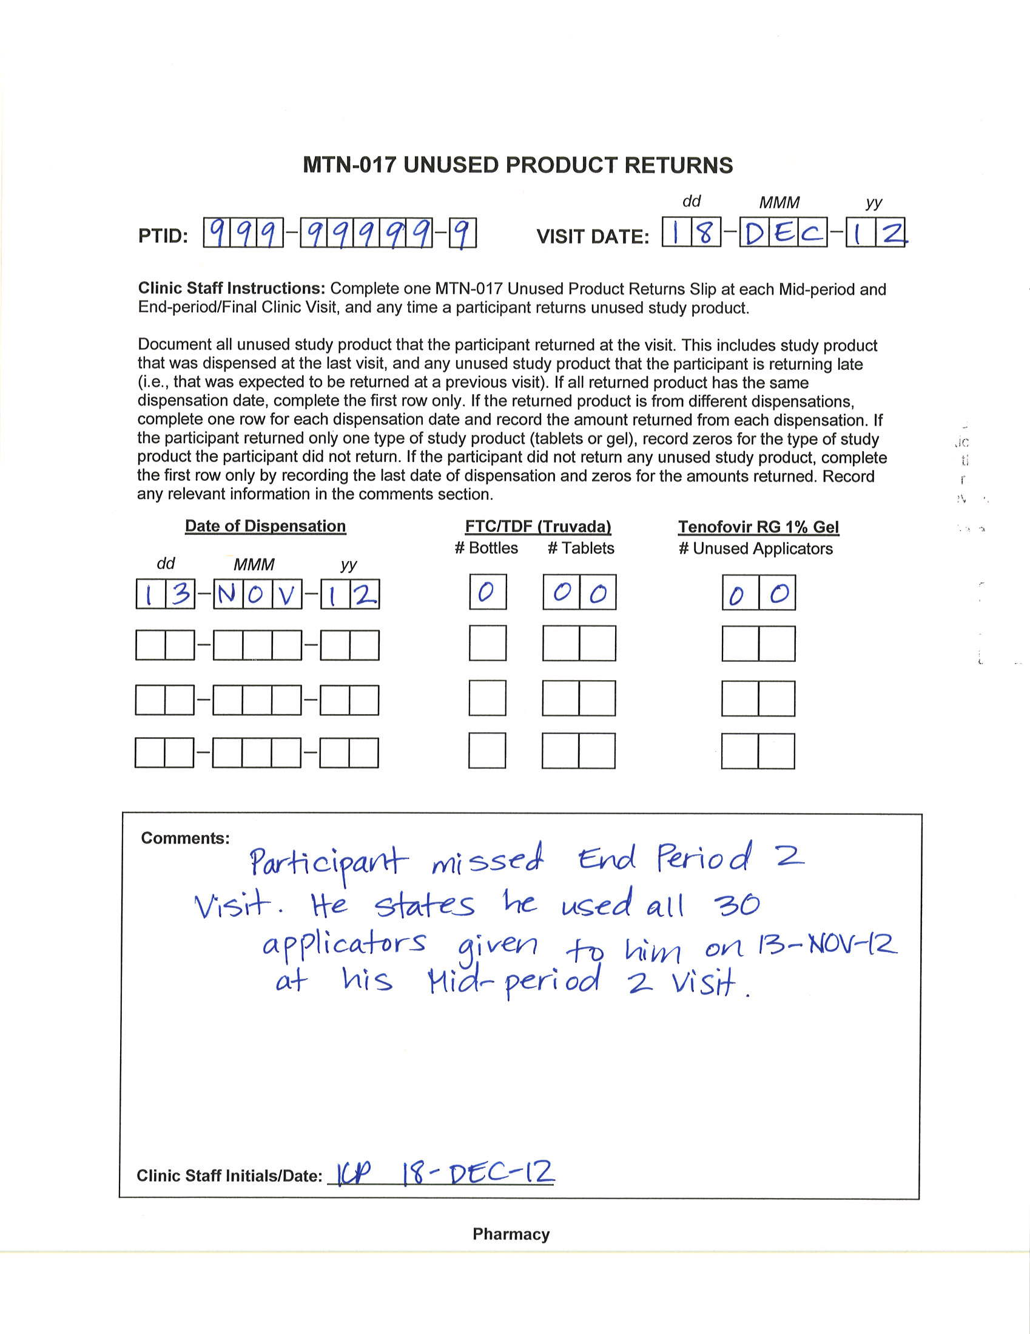
Notes:
Slip not typically completed at Initiate Period Visits, since product was expected to be returned at the End Period Visit. However, since product was returned at the Initiate Period 3 visit, the slip needs to be completed (even if nothing was returned) to cover the period since the last completed visit (Mid-period 2 Visit).

Slide 56
0
8
0
9
9
9
9
9
9
9
9
9
1
8
D
E
C
1
2
0
0
0
0
None unused (all used) from 30 dispensed at Mid-period 2 Visit.
0
0
3
0
0
0
0
0
0
0
0
0
x
Notes:
ONLY document returns from what was dispensed on the last PDR completed, which was at the Mid-period 2 Visit.

Slide 57

Any questions on documenting product returns?
Moving on to the Data Convergence Interview CRF …

Slide 58
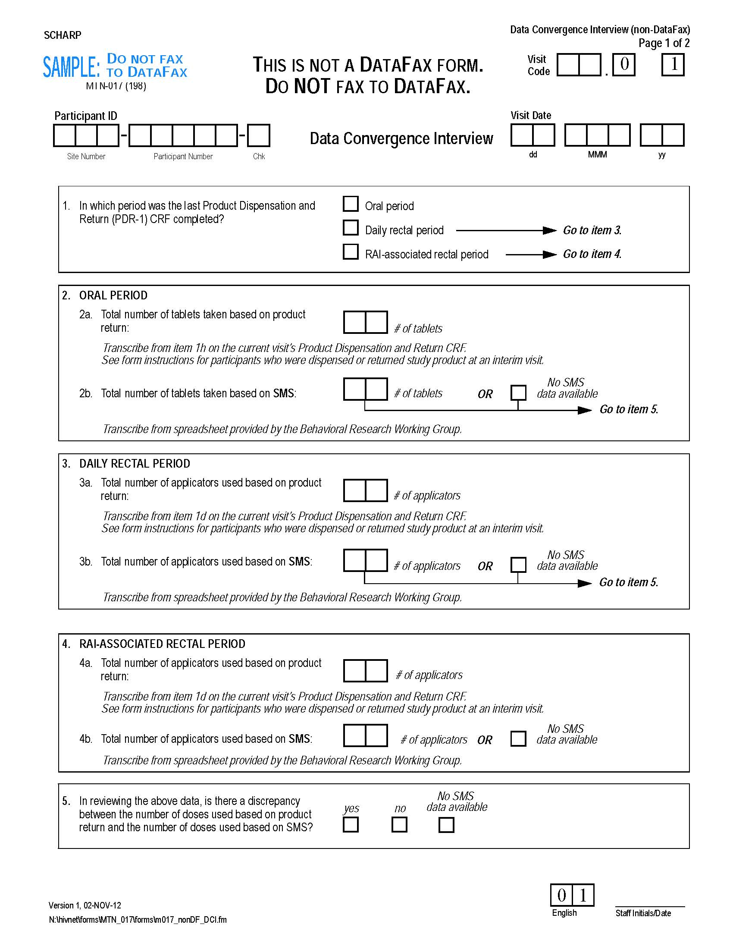
Data Convergence Interview CRF
PDR CRF is source for items 2a, 3a, and 4a
-need to calculate for interim visits
Notes:
Mention need to add total number used over the whole 4-week period (include interim visit calculations)

Slide 59
Transcribe onto DCI form (1d or 1h)
Notes:
Mention need to add total number used over the whole 4-week period (include interim visit calculations)

Slide 60
Data Convergence Interview CRF
Item 1 asks in which period the last PDR was completed
Notes:
Item 1 – tells SCHARP/BRWG which product regimen’s data is being reviewed/discussed; accounts for interviews that are made up in a different period than the missed interview (e.g., End Period 1 Visit is missed and data convergence interview is made up at Initiate Period 2 Visit)

Slide 61
Data Convergence Interview CRF
Form data entered on-line by site staff
On SCHARP server
Reviewed by BRWG
Notes:
The on-line questionnaire link will be in the behavioral section of the SSP; set up BRWG (Ivan) will conduct a separate site training on how to conduct the data convergence interviews.

Slide 62
Thank You!
QUESTIONS

